Slide 1
B.killivalavan
au821721243030 B.Tech AI&DS SINCET
Naan Mudhalvan Project

Slide 2

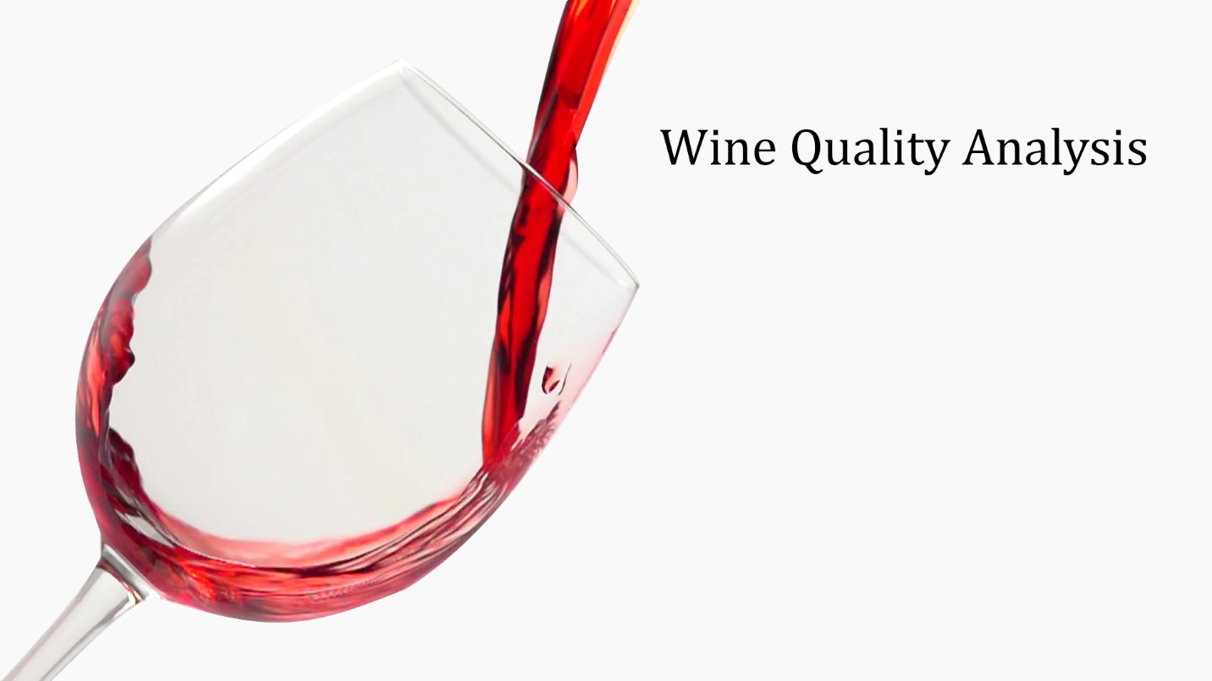
WINE QUALITY PREDICTION
WINE QUALITY PREDICTION USING RNN

Slide 3


AGENDA
Introduction
Data Acquisition and Preprocessing
Neural Network Architecture Design
Model Training
Model Evaluation
Model Optimization and Fine-Tuning
Deployment
Conclusion
3/21/2024 Annual Review

Slide 4

PROBLEM STATEMENT
Wine quality assessment is a crucial task for winemakers and consumers alike. However, traditional methods of wine quality evaluation involve extensive sensory analysis and expert judgment, which can be time-consuming and subjective. In this context, the utilization of machine learning techniques presents an opportunity to develop accurate predictive models for assessing wine quality.
The problem statement revolves around developing a robust predictive model capable of accurately predicting the quality of wines based on various physicochemical properties and sensory attributes. The objective is to create a model that can effectively differentiate between low, medium, and high-quality wines, providing valuable insights for both producers and consumers.

Slide 5

PROJECT OVERVIEW
"Our project aims to develop a machine learning model for predicting wine quality based on various chemical and sensory features.
By leveraging a dataset containing attributes like acidity, alcohol content, and pH levels, we will train a predictive model to classify wines into quality categories.
This project not only offers insights into the relationship between wine characteristics and perceived quality but also provides a practical tool for producers and consumers to assess wine quality more accurately."

Slide 6

WHO ARE THE END USERS?
Wine Producers
Wine Distributors
Wine Retailers
Restaurants
Wine Enthusiasts
Wine Critics and Sommeliers
Wine Importers
Hospitality Industry
Wine Educators
Wine Researchers

Slide 7
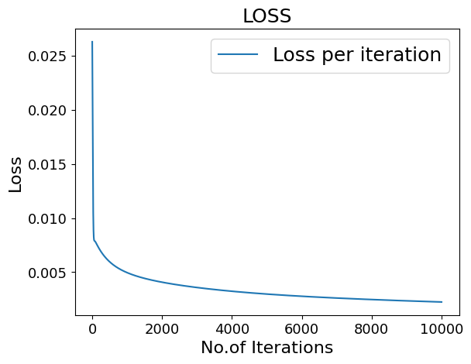
YOUR SOLUTION AND ITS VALUE PROPOSITION
Loss per iteration

Slide 8
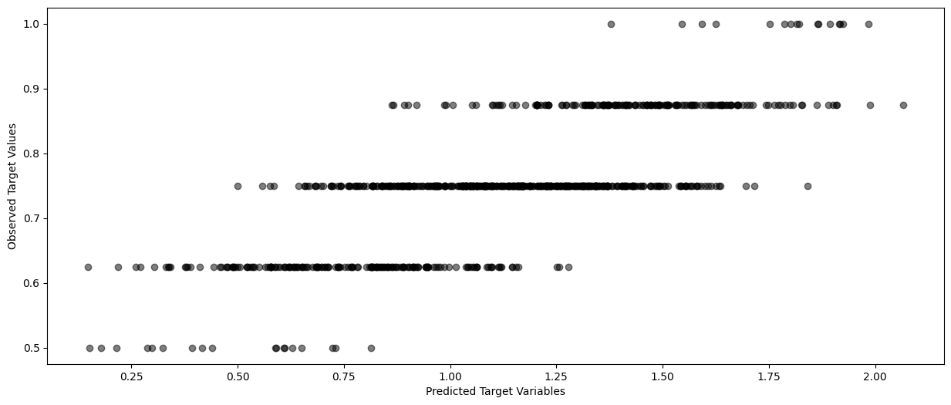
THE WOW IN YOUR SOLUTION
Predicted target value:
‹#›

Slide 9
MODELLING
To predict wine quality, you could use a machine learning approach such as regression or classification models.
Start by preprocessing data, including feature scaling and handling missing values.
Then, train models like Random Forest, Gradient Boosting, or Support Vector Machines on features like acidity, alcohol content, and pH levels to predict wine quality ratings.
Evaluate model performance using metrics like Mean Absolute Error (MAE) or accuracy, and consider techniques like cross-validation for robustness.
‹#›

Slide 10
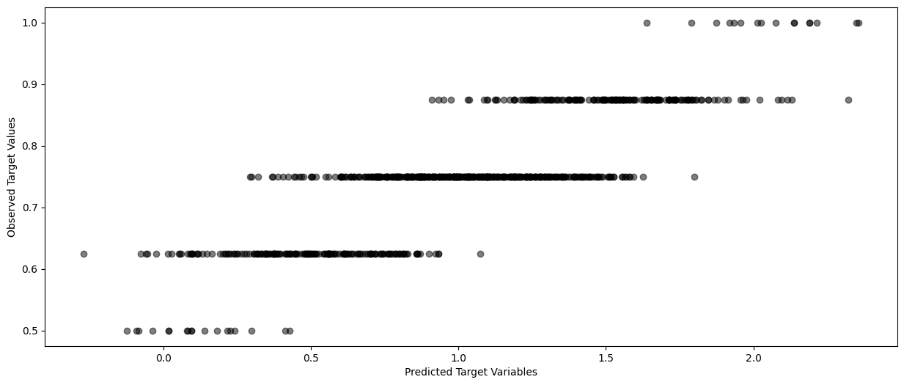
RESULTS
Predicted target value vs Observed target value
‹#›

